Slide 1
Two-Dimensional Arrays

Slide 2
Terminology
Two-dimensional arrays represent matrices
A matrix contains a number of values of the same data type
The values in a matrix are organized in rows and columns
The number of rows and columns in a matrix are called the dimensions of the matrix
Rows and columns are numbered 0,1,2, …
An example of 2X3 matrix of double values:
4.1 -3.2 0
3.3 -1.5 1.8

Slide 3
Examples of matrices
A matrix containing the scores of 3 exams for 5 students:
  80 71
  40 30
  65 80
  71 76
  21 50
A matrix containing the distances between 4 cities:
  0 800 700 600
  800 0 300 500
  700 300 0 650
  600 500 650 0

Slide 4
Declaring matrices
The general form to declare a matrix:
data-type array-name[expression1][expression2];
data-type is the type of array elements. Examples: int, double, char,…
array-name must be a valid identifier
expression1 and expression2 must evaluate to integers and cannot contain variables
The value of expression1 is the number of rows
The value of expression2 is the number of columns

Slide 5
Multiple-Subscripted Arrays
Multiple subscripts
  a[ i ][ j ]
  Tables with rows and columns
  Specify row, then column
  “Array of arrays”
    a[0] is an array of 4 elements
    a[0][0] is the first element of that array
Column 0
Column 1
Column 2
Column 3
Row 0
a[ 0 ][ 0 ]
a[ 0 ][ 1 ]
a[ 0 ][ 2 ]
a[ 0 ][ 3 ]
Row 1
a[ 1 ][ 0 ]
a[ 1 ][ 1 ]
a[ 1 ][ 2 ]
a[ 1 ][ 3 ]
Row 2
a[ 2 ][ 0 ]
a[ 2 ][ 1 ]
a[ 2 ][ 2 ]
a[ 2 ][ 3 ]
Column subscript
Array name
Row subscript

Slide 6
Multiple-Subscripted Arrays
To initialize
  Default of 0
  Initializers grouped by row in braces
  int b[ 2 ][ 2 ] = { { 1, 2 }, { 3, 4 } };
  int b[ 2 ][ 2 ] = { { 1 }, { 3, 4 } };
1 2
3 4
Row 0
Row 1
1 0
3 4

Slide 7
Multiple-Subscripted Arrays
Referenced like normal
      cout << b[ 0 ][ 1 ];
  Outputs 0
  Cannot reference using commas
      cout << b[ 0, 1 ];
    Syntax error
Function prototypes
  Must specify sizes of subscripts
    First subscript not necessary, as with single-scripted arrays
  void printArray( int b[][ 3 ] );
1 0
3 4

Slide 8
Declaration Examples
int a[][]; //compiler error
int a[][10]; //compiler error
int a[5][]; //compiler error
int a[5][10]; //ok
The number of columns must always be provided.
int a[2][]={{1,2},{3,4}}; //compiler error
int a[][2] ={{1,2},{3,4}}; //ok
int a[2][2]={{1,2,3,4}}; //ok
int x; cin>>x; int a[x][10]; //compiler error

Slide 9
Example: Given float B[4][5]={ …};
Write a code segment to print the values of elements in B row by row.
int I, J;
for( I=0; I <=3; I++ )
{
for (J=0; J<=4; J++)
{
cout<<B[I][J]<<“ \t“;
}
cout<<endl; }

Slide 10
Example: Given float B[2][3]={ …};
Write a code segment to read the values of elements in B column by column.
int I, J;
for( J=0; J <3; J++ )
for(I=0; I<2; I++)
cin>>B[I][J];

Slide 11
Example: Given float B[4][4]={ …};
Write a code segment to find the maximum in B.
int I, J;
float max=B[0][0];
for( I=0; I <=3; I++ )
for(J=0; J<=3; J++)
if (B[I][J]>max)
max=B[I][J];
cout<<max;

Slide 12
Example: Given float B[4][4]={ …};
Write a code segment to find the location of the maximum in B.
int I, J, row, column;
float max=B[0][0];
row=column=0;
for( I=0; I <=3; I++ )
for(J=0; J<=3; J++)
if (B[I][J]>max){
max=B[I][J];
row=I;
column=J;
}
cout<<max<<row<<column;

Slide 13
Example: Given float B[4][4]={ …};
Write a code segment to print the elements on the main diagonal in B.
int I, J;
for( I=0; I <=3; I++ )
for(J=0; J<=3; J++)
if (I==J)
cout<<B[I][J];

Slide 14
Example: Given float B[4][4]={ …};
Write a code segment to print the elements above the main diagonal in B.
int I, J;
for( I=0; I <=3; I++ )
for(J=0; J<=3; J++)
if (I<J)
cout<<B[I][J];

Slide 15
Example: Given float B[4][4]={ …};
Write a code segment to print the elements below the main diagonal in B.
int I, J;
for( I=0; I <=3; I++ )
for(J=0; J<=3; J++)
if (I>J)
cout<<B[I][J];

Slide 16
Example: Given float B[4][4]={ …};
Write a code segment to compute the sum of elements on the second row in B.
int J;
float sum=0;
for(J=0; J<=3; J++)
sum+=B[1][J];

Slide 17
Example: Given float B[4][4]={ …};
Write a code segment to compute the sum of elements on the last column in B.
int I;
float sum=0;
for(I=0; I<=3; I++)
sum+=B[I][3];

Slide 18
Example: Given float B[4][4]={ …};
Write a code segment to exchange the first two columns in B.
int I;
float temp;
for(I=0; I<=3; I++){
temp=B[I][0];
B[I][0]=B[I][1];
B[I][1]=temp;
}

Slide 19
Example: Given float B[4][4]={ …}; float C[4][4]={ …}; float A[4][4];
Write a code segment to add B and C and store the result in A.
int I, J;
for(I=0; I<=3; I++)
for(J=0; J<=3; J++)
A[I][J]=B[I][J]+C[I][J];

Slide 20
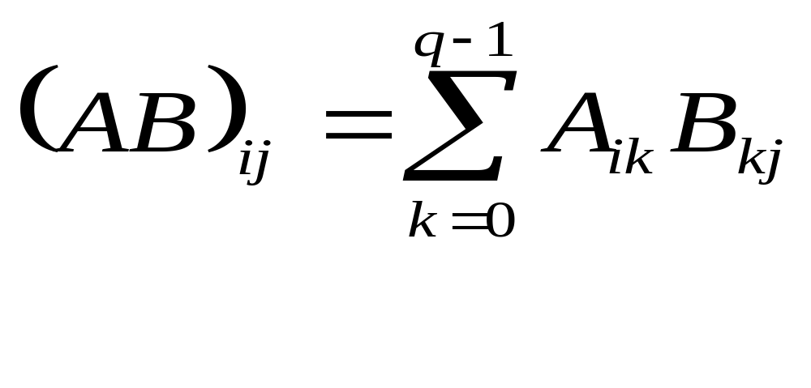
Matrix multiplication
1 3 7 9 1 2 1 8 12 24
6 4 2 1 * 0 1 0 = 8 18 11
1 1 2
0 0 1
A (pXq) B (qXr) AB (pXr)
2X4 4X3 2X3

Slide 21
Example: Given float B[4][8]={ …}; float C[8][5]={ …}; float A[4][5];
Write a code segment to multiply B and C and store the result in A.
int I, J,K;
double sum;
for(I=0; I<=3; I++)//to populate all A
for(J=0; J<=4; J++){//to populate the 1st line of A
sum=0;
for(K=0,K<=7;K++)
sum+=B[I][K]*C[K][J];//each element in A
A[I][J]=sum;
}

Slide 22
Two-Dimensional Arrays As Parameters
Matrices are passed by reference; similar to one-dimensional arrays
The number of columns in the formal parameter matrix must be specified
The number of rows in the formal parameter matrix is usually omitted
Some examples:
void f(int a[][]){a[0][0]=10;}//compiler error
void f(int a[][10]){a[0][0]=10;}//ok
void f(int a[10][]){a[0][0]=10;}//compiler error

Slide 23
Example: write a function to set the elements of a 5X7 matrix of integers to 100.
void store100(int X[5][7]){ // The 5 can be omitted
int I, J;
for(I=0; I<=4; I++)
for(J=0; J<=6; J++) X[I][J]=100;
}

Slide 24
Example: write a function to print the elements of a 5X7 matrix of integers.
void printMatrix(int X[5][7]){
int I, J;
for(I=0; I<=4; I++){
for(J=0; J<=6; J++) cout<<X[I][J]<<" ";
cout<<endl;
}

Slide 25
Example: write a function to print the elements of a matrix of integers. The function should receive matrices of varying number of rows and 7 columns.
#include <iostream.h>
void printMatrix(int [][7], int);
void printMatrix(int X[ ][7], int rows){
int I, J;
for(I=0; I<=rows-1; I++){
for(J=0; J<=6; J++) cout<<X[I][J]<<" ";
cout<<endl;
}
//an example of using printMatrix
void main(){
int A[2][7]={{1,2,2,2,4,5,4}, {5,5,5,9,9,0,0}};
int B[3][7]={{1,2,2,2,4,5,4}, {5,5,5,9,9,0,0},{0,0,0,0,1,1,1}};
printMatrix(A,2);
printMatrix(B,3);
}

Slide 26
Example: write a function to compute the average of elements of a matrix of integers. The function should receive matrices of varying number of rows and 7 columns.
#include <iostream.h>
double matrixAvg(int [][], int);
double matrixAvg(int X[ ][7], int rows){
int I, J, sum=0;
for(I=0; I<=rows-1; I++)
for(J=0; J<=6; J++) sum+=X[I][J];
return (double)sum/(rows*7);
}
//an example of using matrixAvg
void main(){
int A[2][7]={{1,2,2,2,4,5,4}, {5,5,5,9,9,0,0}};
int B[3][7]={{1,2,2,2,4,5,4}, {5,5,5,9,9,0,0},{0,0,0,0,1,1,1}};
cout<<matrixAvg(A,2);
cout<<matrixAvg (B,3);
}

Slide 27
Matrices of Characters
Used to store a list of names in memory.
Example:
char N[3][6]={“ali”, “ahmad”, “sami”};
char M[3][6]={{'a', 'l', 'i', NULL}, {'a', 'h', 'm', 'a', 'd',NULL}, {‘s', ‘a', 'm', ‘i', NULL}};
char M[][6]={{'a', 'l', 'i', NULL}, {'a', 'h', 'm', 'a', 'd',NULL}, {‘s', ‘a', 'm', ‘i', NULL}};
cout<<N[1][2]; //m
cout<<N[1]; //ahmad
cin>>N[1]; //ok

Slide 28
Example: Write a code segment to read a list of 100 names and store it in memory. Assume each name does not contain more than 20 characters.
.
char N[100][20];
for(int I=0; I<=99; I++)
cin>>N[I];

Slide 29
Example: Given char N[100][20]={…};
Write a code segment to print the names stored in A.
for(int I=0; I<=99; I++)
cout<<N[I];

Slide 30
Example: Write a function that receives a matrix containing a list of names and returns the number of names starting with the letter 'd'.
int countNames (char X[][20], int rows){
int count=0;
for(int I=0; I<=rows-1; I++)
if(X[I][0]=='d') count++;
return count;
}

Slide 31
Matrices as Arrays of Arrays
A matrix like
int A[4][3];
is a one dimensional array of 4 elements: A[0], A[1], A[2], A[3]. Each of these arrays is a one-dimensional array of 3 elements. For example, A[0] is a one-dimensional array containing the elements A[0][0], A[0][1], A[0][2].
Rows of a matrix can be treated as one dimensional array. For example,
int sum(int X[ ], int sz){…}
void main(){
int A[10][20]={…};
cout<<sum(A[0],20);
}

Slide 32
Example: Write a function to compute the length of a string stored in a one-dimensional array. Then, write another function that receives a matrix containing a list of names and prints the longest name in the matrix. The second function should call the first function.
int length(char N[]){ int i=0; for(i=0; N[i]; i++); return i; }
void printLongest(char X[][20], int m){
int Loc=0;
int maxLength=length(X[0]);
for(int I=0; I<=m-1; I++)
if(length(X[I])>maxLength){
maxLength=length(X[I]);
Loc=I;
}
cout<<X[Loc];
}

